Slide 1
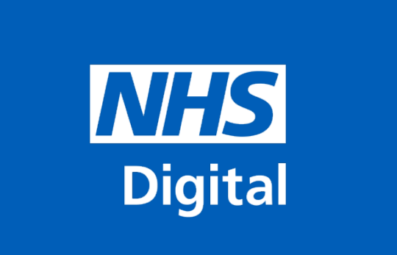
Public Health England VINE Glasses Workshop
Tuesday 5th March
Rebecca Gorton and Michael Cheung

Slide 2
Agenda
10:30am –10:50am: Set-up, introduction and pairing
10:50am – 11:00am: Getting to know the glasses - Mobility
11:00am – 11:15am: Getting to know the glasses - Reading and Writing
11:15am - 11:30am: First session feedback
11:30am – 11:35am: Comfort Break
11:35am – 11:45am: Introduction to accessibility tools
11:45am – 12:00pm: Everyday use
12:00pm – 12:15pm: ‘Usability session’
12:15pm – 12:30pm: Discussion & feedback

Slide 3
What does accessibility mean?
Accessibility means that people can do what they need to do in a similar amount of time and effort as someone that does not have a disability.

Slide 4
What does web accessibility mean?
Web accessibility means that people with disabilities can use the Web when they need to in a similar amount of time and effort as somebody who does not have a disability.

Slide 5
Which disability are we talking about? Visual
2 million people in the UK have some form of sight loss
360,000 people are registered as blind or partially sighted
Notes:
Visual – meaning vision loss (partial or full, in one or both eyes), or reduced or increased sensitivity to certain colours or bright colours.
Quick facts - 2 million people in the UK have some form of sight loss. 360,000 are registered as blind or partially sighted.
Colour blindness affects approx. 1 in 12 men, and 1 in 200 women.
Need to consider - use of font, font sizes and styles, colours and contrast, layouts, images when designing web content.

Slide 6
Also..
Other disabilities include Auditory, Physical
and Neurological
13.9 million people in the UK have a disability
The Equality Act (2010) prohibits discrimination
by disability

Slide 7
What are the VINE glasses?
Visual Impairment North East is a UK-Registered charity. Their aim is to improve the lives of Visually Impaired people through promoting greater understanding of eye conditions and the problems faced by Visually Impaired people. The 10 pairs of spectacles in the pack simulate the most common symptoms of the most common eye conditions.
Total loss of peripheral vision (tunnel vision)
Loss of half of visual field (right sided hemianopia)
Loss of half of visual field (left sided hemianopia)
Reduced clarity of vision (just below UK driving standard)
Loss of central vision (early stage)
Hazy vision with light scatter and glare
Loss of central vision (advanced stage)
Patchy vision
Light perception only in one eye and poor vision in the other
Light perception only in both eyes

Slide 8
Getting to know the glasses
Mobility

Slide 9
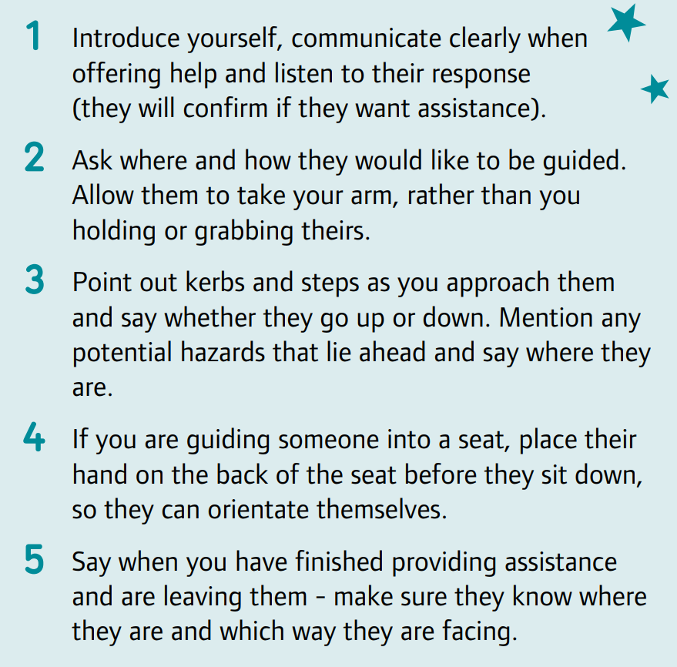
Tasks: 1. Correct grip and straight-line guiding 2. Guiding to a seat and sitting down 3. Guide out of the room and back in again – the person using the glasses must be as independent as possible, the guide is not to do any of the exercises (such as opening doors, moving objects etc.) for them. 4. Switch roles

Slide 10
Getting to know the glasses
Reading & Writing

Slide 11
Tasks: 1. Have a look at the low contrast picture and write down what you can see 2. Have a look at the high contrast picture and write down what you see 3. Read a couple of pages of the newspaper and note any techniques 4. Practice signing your name and writing some sentences

Slide 12
How did you find that?

Slide 13
Break

Slide 14
Do what you do!

Slide 15
Accessibility tools

Slide 16
Types of assistive technology
Screen readers
Screen magnification software
Speech input software
Text readers
Alternative input devices

Slide 17
Let’s have a look

Slide 18
Usability Testing

Slide 19
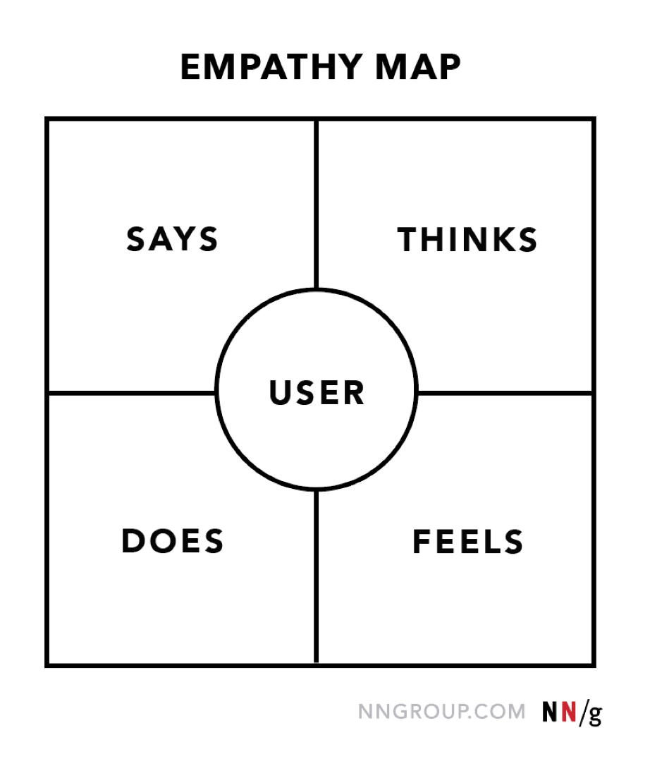

Slide 20
What did you find out?

Slide 21
Thanks & Feedback

